Slide 1
Generating noisy speech data from clean data in the frequency domain using Deep Learning Methods
Week – 15
Name: Shashank Shirol
University: Manipal Institute of Technology
Duration of the presentation: ~10 mins.

Slide 2
Tasks to be completed:
Implement a module to split a spectrogram into equal parts and preserve the order, use padding to make-up for un-even spectrograms.
To incorporate the module into a component-based custom data-loader that takes care of reading audio files, extracting spectrograms and splitting the spectrograms to be fed to the model. The individual tasks handled by the custom data loader are as follows:
To read the input audio files, extract spectrograms.
To split the spectrograms into components and to keep track of the number of components of each training example.
Treat each component as an independent sample.
To optimize the process of splitting the spectrograms into components – making use of parallel processing.
To compare the efficacy of using a component-based data loader to the old data loader

Slide 3
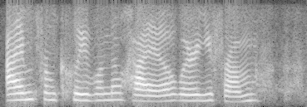
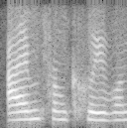
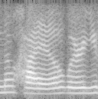
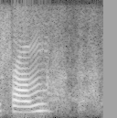
Implement a module to split spectrograms into equal parts
In order to achieve this, we pad the spectrogram to enable equal splits.
We make use of median-pad, where in we make use of the median value of a spectrogram to pad the spectrogram.
The results are as follows:

Slide 4
Incorporating the module into a Custom Data Loader (I)
To enable us to use a component-based Data Loader, we had to come up with a way that can keep track of the order of components generated from a given spectrogram;
Then, to scale this method to be able to apply it to all spectrograms of training samples.
And modify the data structure used to store these components such that we could treat each component as an independent example.
Solution: Generate spectrograms and make splits at the initialization of the Data Loader. Problem: Performance overhead of extracting spectrograms and then splitting them.
Hence, we make use of Parallel Processing capabilities – using Threads.
This reduces the time required to initialize the data-loader (for 10 audio files with about 60 components) – from ~2.0 secs to ~0.7 secs.

Slide 5
Incorporating the module into a Custom Data Loader (II)
Implementational Details:
We make use of joblib library to achieve parallel processing. We create ‘n’ jobs where n is the number of cores available and process the audio files parallelly – extracting spectrograms and splitting components.
We then make use of an OrderedDict to keep track of the number of components of a given training example (required for reconstruction). We add this as an attribute to the Data Loader class that is accessed via its object.
We make use of a ‘state’ parameter that distinguishes between training and testing phase. We require a lot less processing during the training phase, thus this helps us save time.
In the reconstruction module, we process a component an example and “wait” for accumulation of its remaining components before the reconstruction process begins.
We concatenate the component results, chop off the excess padding and reconstruct audio as before.

Slide 6
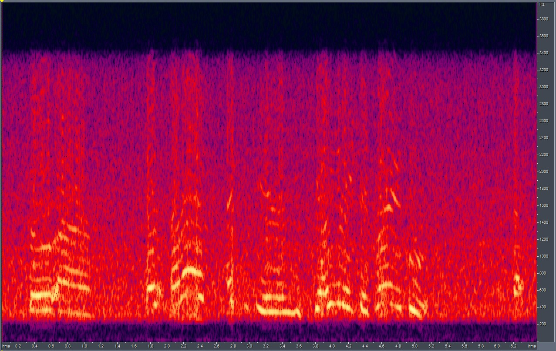
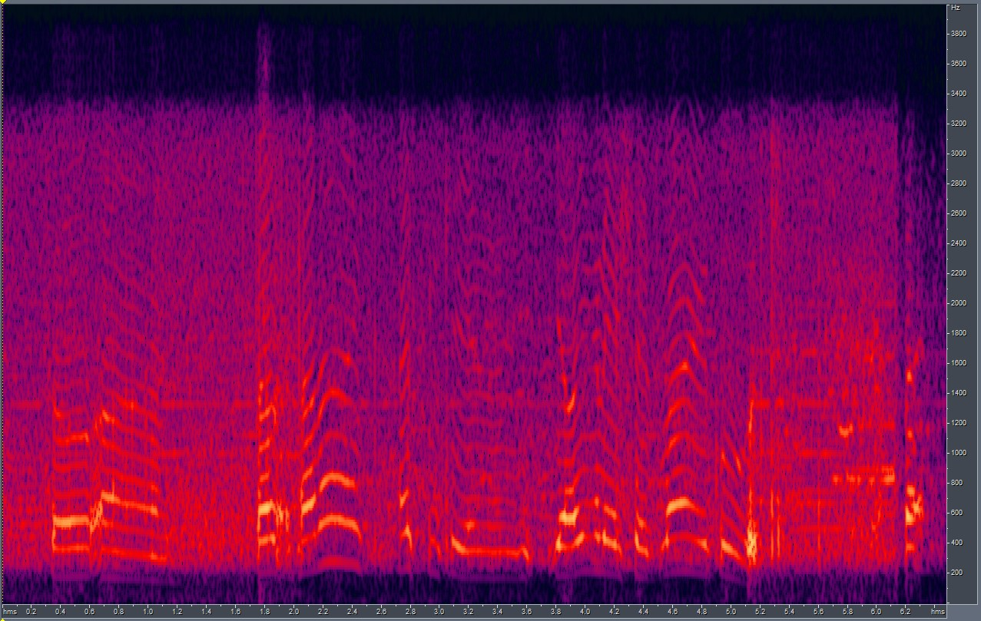
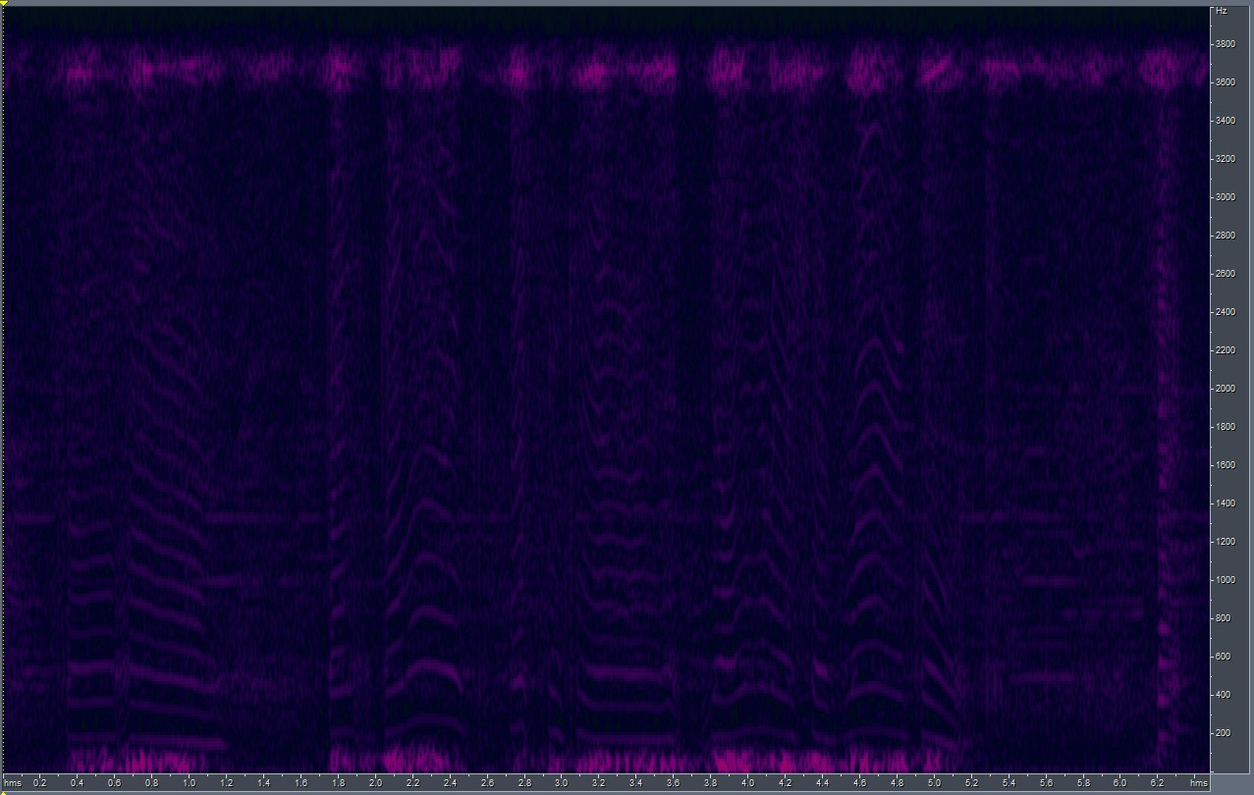

Comparing the Results of using a component-based approach and older approach (I)
Before we get into the results, we discuss a few merits of using the component based approach:
By splitting the spectrograms into components (shorter spectrograms) and treating them like individual samples, we increase the number of training examples for CUT.
This approach resulted in shorter training time than the old way – 1 hr to 1.75 hrs for the same dataset
Results:
The old approach fails to converge and produce good results with 10 training samples, by splitting the samples into components we get more training samples effectively and the thus produce better results.
LSD w/ comp-based model = 7.75; LSD w/o comp-based model = 15.78; (DID NOT USE g726 Codec)
GT
Comp-based O/P
Non Comp-based O/P

Slide 7
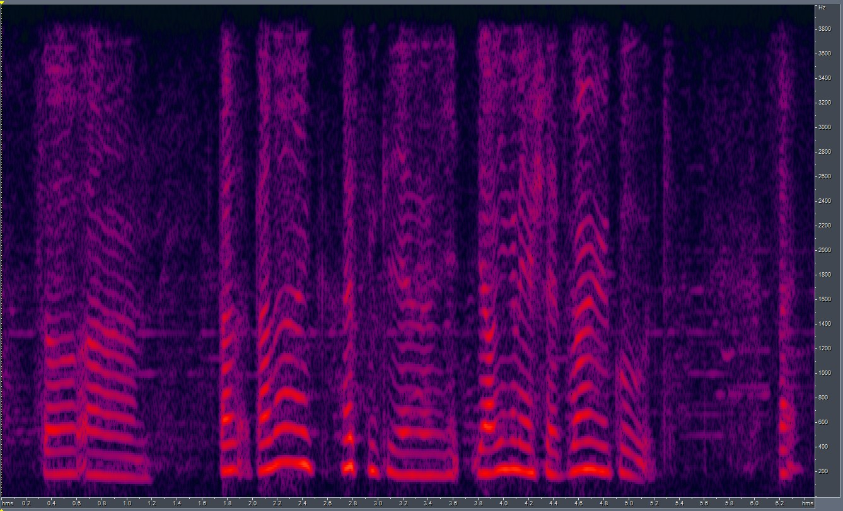
Comparing the Results of using a component-based approach and older approach (II)
In order to verify the fact that model indeed failed to converge due to less number of training samples, we re-train the old model with more training samples (25, instead of 10).
We see that the LSD score falls to 11.56 (from 15.78); and, we can also hear utterances a bit more clearly now.
Non Comp-based O/P (more training)

Slide 8
End.

